Slide 1
Object Comparisons Finding Prime Numbers C++ & Java
Adam Feldscher
I699 Performance Design Patterns II
10/16/2019

Slide 2
Modifications
All tests are done for primes up to 10k, with 40 iterations
1k had too much noise
Java and C++
Java Primitives vs Wrappers
PrimeFinder Class Invoction
New instance per each iteration
Bring SQRT into for loop comparison
Adding is_prime method

Slide 3
Algorithm (Java)
for (int iter = 0; iter < max_iter; iter++) {
// insert delays
long start_time = System.nanoTime();
for (int n = 2; n <= max_prime; n++) {// 2 - 10k, 1m, 5m
int max_divisor = (int) sqrt(n);
boolean is_prime = true;
for (int i = 2; i <= max_divisor; i++) {
if (n % i == 0) {
is_prime = false;
break;
}
}
if (is_prime) {
num_primes_found++;
}
}
long end_time = System.nanoTime();
// print things
num_primes_found = 0;
}

Slide 4
Java Consistency Check
Notes:
Retest in linux….

Slide 5
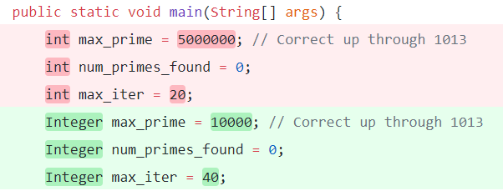

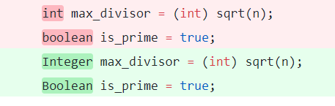
Java Primitives vs Wrappers

Slide 6
Java Primitives vs Wrappers (Integer)
Notes:
Significant!
Scale difference from last

Slide 7
Java PrimeFinder Class
public class PrimeFinder {
private Integer max_prime;
public PrimeFinder(Integer max_prime) {
this.max_prime = max_prime;
}
public Integer find_primes() {
Integer num_primes_found = 0;
for (Integer n = 2; n <= max_prime; n++) {
Integer max_divisor = (int) sqrt(n);
Boolean is_prime = true;
for (Integer i = 2; i <= max_divisor; i++) {
if (n % i == 0) {
is_prime = false;
break;
}
}
if (is_prime) {
num_primes_found++;
}
}
return num_primes_found;
}
}
public static void main(String[] args) {
for (Integer iter = 0; iter < max_iter; iter++) {
//Start Timer
PrimeFinder primeFinder = new PrimeFinder(iter, max_prime);
num_primes_found = primeFinder.find_primes();
//End timer & Print
}

Slide 8
Java PrimeFinder Class
Notes:
Surprising that there’s not more change

Slide 9
C++ PrimeFinder Class
PrimeFinder::PrimeFinder(int max_prime) {
_max_prime = max_prime;
}
int PrimeFinder::find_primes() {
int num_primes_found = 0;
int n;
for (n = 2; n <= _max_prime; n++) {
int max_divisor = (int) sqrt(n);
bool is_prime = true;
int i;
for (i = 2; i <= max_divisor; i++) {
if (n % i == 0) {
is_prime = false;
break;
}
}
if (is_prime) {
num_primes_found++;
}
}
return num_primes_found;
}
class PrimeFinder
{
private:
int _max_prime;
public:
PrimeFinder(int max_prime);
int find_primes();
};

Slide 10
C++ PrimeFinder Class
Notes:
Gets entirely optimized out

Slide 11
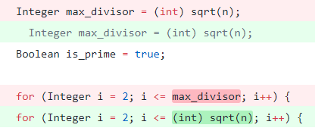
Java Prime Finder + SQRT

Slide 12
Java Prime Finder + SQRT
Notes:
Almost no impact

Slide 13
C++ PrimeFinder + SQRT

Slide 14
Java IsPrime Method
public class PrimeFinder {
private Boolean is_prime(Integer n) {
Integer max_divisor = (int) sqrt(n);
for (Integer i = 2; i <= max_divisor; i++) {
if (n % i == 0) {
return false;
}
}
return true;
}
public Integer find_primes() {
Integer num_primes_found = 0;
for (Integer n = 2; n <= max_prime; n++) {
if (is_prime(n)) {
num_primes_found++;
}
}
return num_primes_found;
}
}

Slide 15
Java IsPrime Method
Notes:
Some weirdness, not sure if it jits faster because there are smaller units, or if its just noise. JIT LOG

Slide 16
C++ IsPrime Method
bool PrimeFinder::is_prime(int n) {
int max_divisor = (int) sqrt(n);
for (int i = 2; i <= max_divisor; i++) {
if (n % i == 0) {
return false;
}
}
return true;
}
int PrimeFinder::find_primes() {
int num_primes_found = 0;
int n;
for (n = 2; n <= _max_prime; n++) {
if (is_prime(n)) {
num_primes_found++;
}
}
return num_primes_found;
}

Slide 17
C++ IsPrime Method
Notes:
No change

Slide 18
Java 1K tests
Notes:
1k has more details but also more noise.
Linux

